Slide 1
RAG RAG - Retrieval Augmented Generation Chetan Gajare.
Notes:
Hi everyone, and welcome to my presentation on Retrieval-Augmented Generation, also known as RAG. Today, we'll delve into this exciting new approach in AI text generation and explore how it overcomes some of the limitations of traditional methods. By the end of this presentation, you'll gain a solid understanding of RAG's core principles, its benefits, and how it's transforming the landscape of AI-powered text creation.

Slide 2
AGENDA
Introduction to AI
What is RAG
Benefits
RAG in Action
Conclusion

Slide 3
INTRODUCTION TO AI

Slide 4
Artificial Intelligence
What is AI
The simulation of human intelligence processes by machines.
Applications span various fields, from robotics and self-driving cars to medical diagnosis
Key Components of AI:
Machine Learning: Enables machines to learn from data without explicit programming. (e.g., image recognition, spam filtering)
Natural Language Processing (NLP): Allows machines to understand and process human language. (e.g., chatbots, sentiment analysis)
Computer Vision: Equips machines with the ability to interpret and analyze visual information. (e.g., facial recognition, object detection)
Reasoning and Problem-Solving: Enables machines to analyze situations, draw conclusions, and make informed decisions.
Notes:
Before diving into RAG, let's take a quick detour to understand the broader landscape of Artificial Intelligence (AI). AI is a branch of computer science focused on creating intelligent machines that can mimic human cognitive functions like learning and problem-solving. We see AI applications in various fields, from robots that assemble complex machinery on factory floors to self-driving cars navigating busy streets. Even medical diagnosis and the personalized recommendations you see on online shopping platforms leverage the power of AI. To achieve these feats, AI relies on several key components:

Slide 5
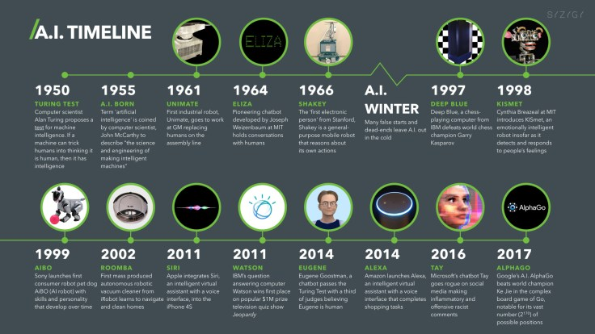

Slide 6
WHAT IS RAG ?

Slide 7
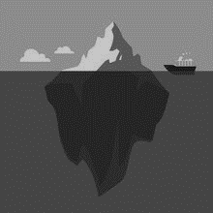
Retrieval-Augmented Generation
RAG is a cutting-edge approach in AI text generation that overcomes limitations of traditional methods.
It injects a dose of accuracy and focus into generated text by leveraging external knowledge sources.
Retrieval
Generation
Imagine RAG as a curious researcher. When given a prompt, it actively searches for relevant information from a vast knowledge base based on the prompt's keywords or meaning.
Just like a researcher using their findings to write a well-informed report, RAG utilizes the retrieved information to guide the generation of text. This ensures the generated text aligns with factual information and stays on topic.
Notes:
Now, let's delve into the heart of our presentation - Retrieval-Augmented Generation, or RAG for short. Traditional AI text generation methods sometimes struggle with factual accuracy and staying focused on the topic. RAG tackles these challenges head-on! Imagine RAG as a researcher with access to a vast library of information. When presented with a prompt, RAG doesn't just rely on its internal knowledge of text patterns. Instead, it actively searches for relevant information from external knowledge sources based on the keywords or meaning within the prompt. Think of it as the researcher gathering relevant articles and data to support their work. Once RAG has retrieved this information, it acts like a well-informed researcher writing a report. The retrieved information guides the generation of text, ensuring the final output is factually accurate, stays on topic, and aligns with the user's intent. This two-step process, retrieval and generation, is what makes RAG so powerful.

Slide 8
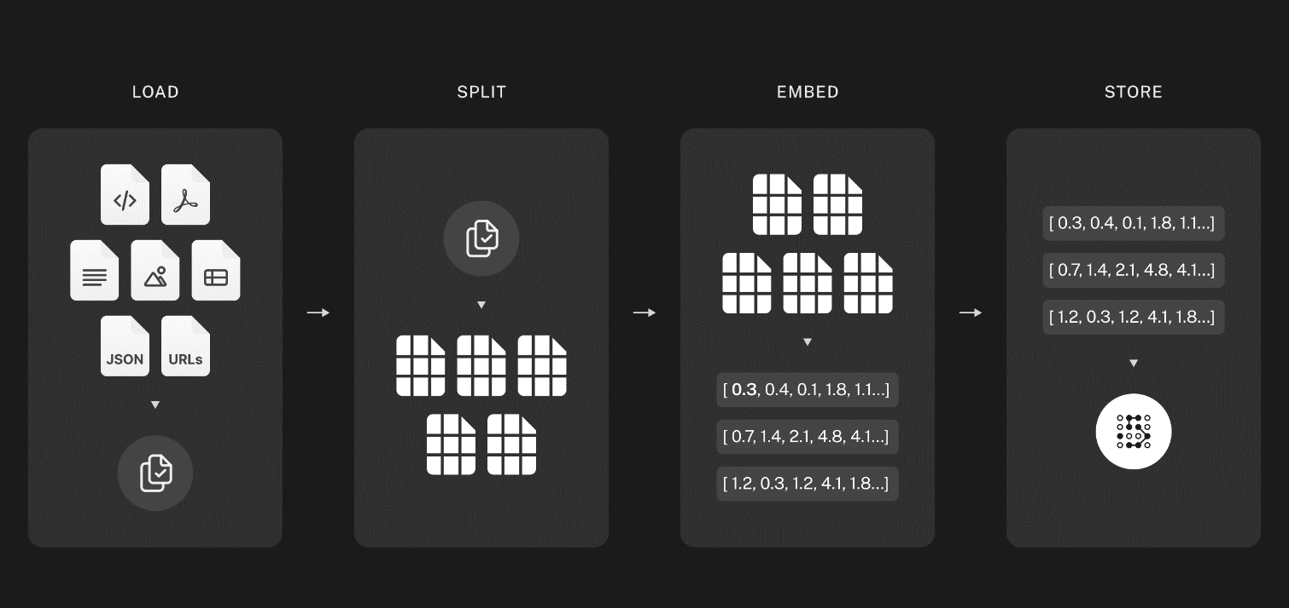
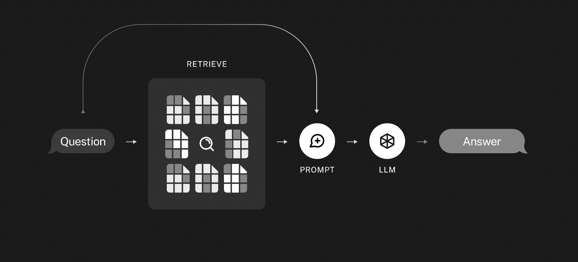
Source : https://python.langchain.com/docs/use_cases/question_answering/
Notes:
Indexing
Load: First we need to load our data. This is done with DocumentLoaders.
Split: Text splitters break large Documents into smaller chunks. This is useful both for indexing data and for passing it in to a model, since large chunks are harder to search over and won’t fit in a model’s finite context window.
Store: We need somewhere to store and index our splits, so that they can later be searched over. This is often done using a VectorStore and Embeddings model.
VectorStore : One of the most common ways to store and search over unstructured data is to embed it and store the resulting embedding vectors, and then at query time to embed the unstructured query and retrieve the embedding vectors that are 'most similar' to the embedded query. A vector store takes care of storing embedded data and performing vector search for you.
Embedding : Embeddings create a vector representation of a piece of text. This is useful because it means we can think about text in the vector space, and do things like semantic search where we look for pieces of text that are most similar in the vector space.
The base Embeddings class in LangChain provides two methods: one for embedding documents and one for embedding a query. The former takes as input multiple texts, while the latter takes a single text. The reason for having these as two separate methods is that some embedding providers have different embedding methods for documents (to be searched over) vs queries (the search query itself).
Retrieval and generation
Retrieve: Given a user input, relevant splits are retrieved from storage using a Retriever.
Generate: A ChatModel / LLM produces an answer using a prompt that includes the question and the retrieved data

Slide 9
Benefits
Improved Accuracy and Factual Grounding:
By incorporating external knowledge, RAG reduces factual inconsistencies and hallucinations commonly seen in LLM-generated text.
Enhanced Coherence and Focus:
The retrieved information helps RAG stay on topic and generate more coherent and focused text aligned with the user's intent.
Adaptability to Specific Domains:
RAG can be tailored to specific domains by using relevant knowledge sources, leading to more specialized and accurate text generation.
Notes:
RAG offers several distinct advantages over traditional LLMs. First and foremost, it tackles the issue of factual accuracy. By leveraging external knowledge sources, RAG ensures the generated text aligns with real-world information, reducing the chances of nonsensical or misleading content. Additionally, RAG promotes coherence and focus in the generated text. The retrieved information acts as a guide, keeping the model on track and producing content that stays true to the user's prompt. Finally, RAG boasts impressive adaptability. By incorporating domain-specific knowledge sources , RAG can be fine-tuned to generate highly specialized and accurate text content within a particular field.
Enhances Relevance: RAG improves the relevance of generated text by incorporating information retrieved from external sources, ensuring that responses are contextually appropriate and accurate.
Increases Accuracy: By leveraging external knowledge sources, RAG reduces the likelihood of generating incorrect or irrelevant responses, resulting in higher accuracy in language generation tasks.
Expands Knowledge Coverage: RAG allows AI models to access and utilize vast amounts of external information, expanding their knowledge coverage beyond what is contained in their training data.
Enables Dynamic Responses: RAG enables dynamic responses that adapt to specific queries or contexts by retrieving and incorporating up-to-date information from external sources.
Enhances User Interaction: With RAG, AI systems can provide more informative and engaging interactions by delivering richer, more contextually relevant responses that meet user needs more effectively.

Slide 10
RAG IN ACTION

Slide 11
DEMO OVERVIEW
Tech Stack
Data Source
Preparing the Data
Creating a Chroma Database
Crafting a Response
Results

Slide 12




Tech Stack
Python
Langchain
Ollama / OpenAi

Slide 13
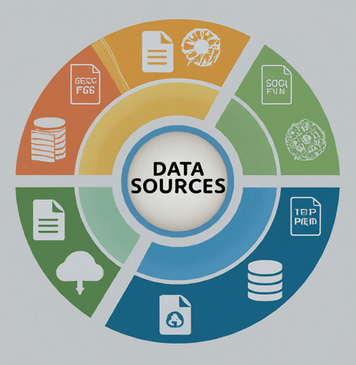
Data Source
Texts
Documents (PDFs)
Database
Notes:
Explain the process of preparing the data for the RAG application.
Discuss loading and splitting the text into chunks to create a dataset.
Mention the importance of organizing the data and ensuring it is in a suitable format for processing. Use document loaders to load data from a source as Document's. A Document is a piece of text and associated metadata. For example, there are document loaders for loading a simple .txt file, for loading the text contents of any web page, or even for loading a transcript of a YouTube video.
Document loaders provide a "load" method for loading data as documents from a configured source. They optionally implement a "lazy load" as well for lazily loading data into memory.

Slide 14
Preparing the Data
This involves splitting the documents into smaller chunks for more focused searching.
Notes:
Describe the steps involved in creating a Chroma database from the text chunks.
Explain the use of vector embeddings generated by OpenAI to represent the text data in the database.
Highlight the significance of the Chroma database in enabling efficient retrieval of relevant information for text generation.

Slide 15
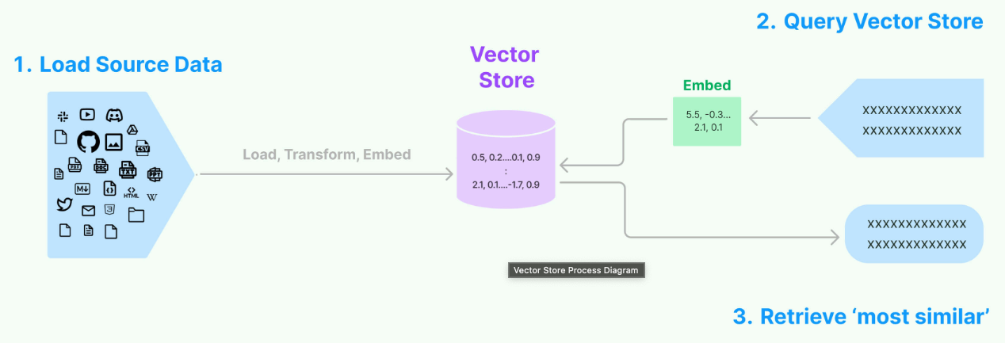
Creating a Chroma Database
ChromaDB, a special database that utilizes vector embeddings to efficiently search through the text chunks.
Notes:
Describe the steps involved in creating a Chroma database from the text chunks.
Explain the use of vector embeddings generated by OpenAI to represent the text data in the database.
Highlight the significance of the Chroma database in enabling efficient retrieval of relevant information for text generation.
Explain how to query the Chroma database for relevant data based on user queries.
Discuss the use of embedding similarity to identify and retrieve text chunks that match the query.
Provide examples of queries and the corresponding retrieved data from the database.

Slide 16
THANK YOU
Chetan Gajare
JPMorgan & Chase

